Slide 1
BZA Case No. 21345
Whittier Elementary Modular Campus
3rd St. NW
(Square 3269, Lot 0065)
Hearing Date:

Slide 2
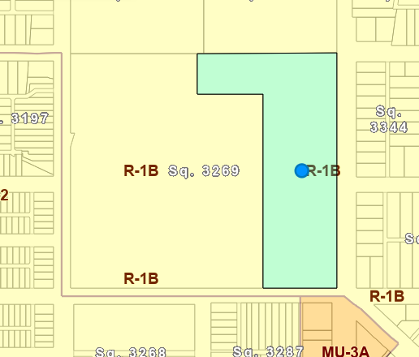
Zoning Map – R-1B Zone

Slide 3
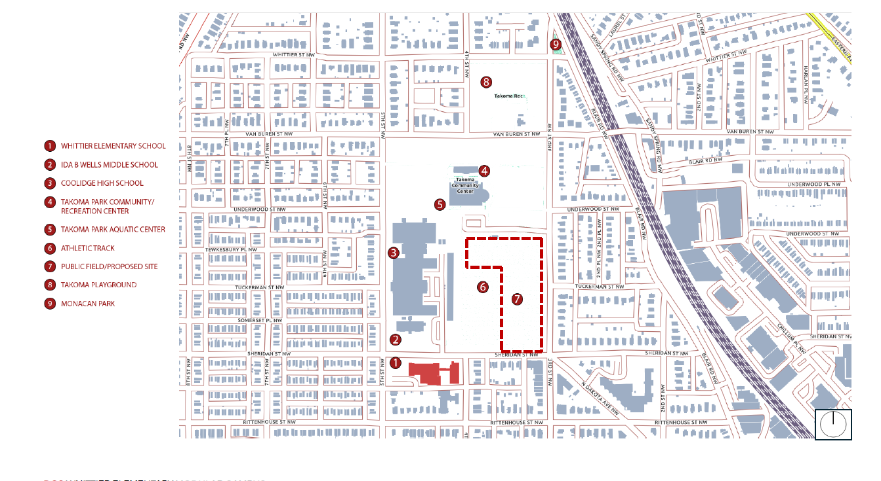
Existing Conditions-Vicinity Map

Slide 4
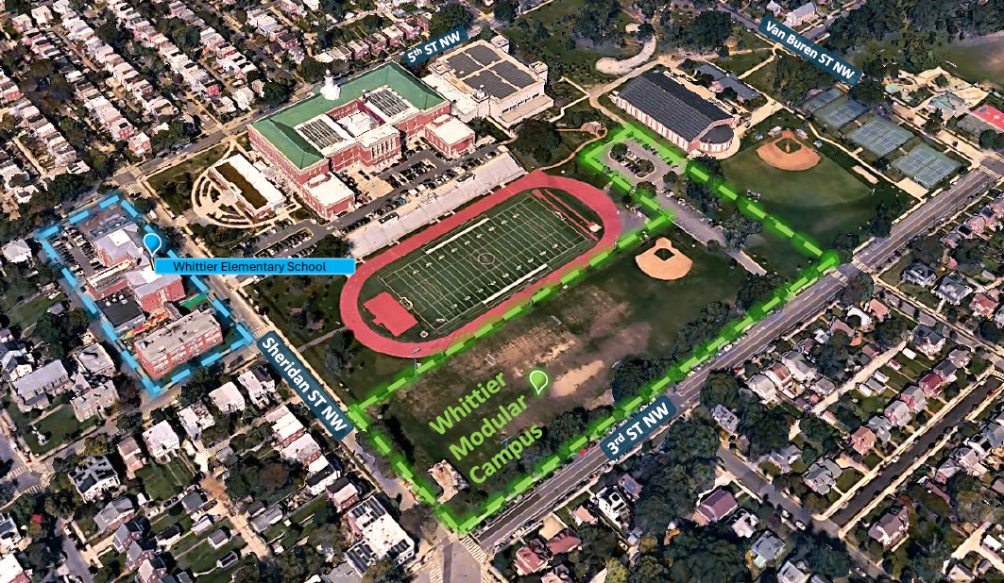
Existing Conditions

Slide 5
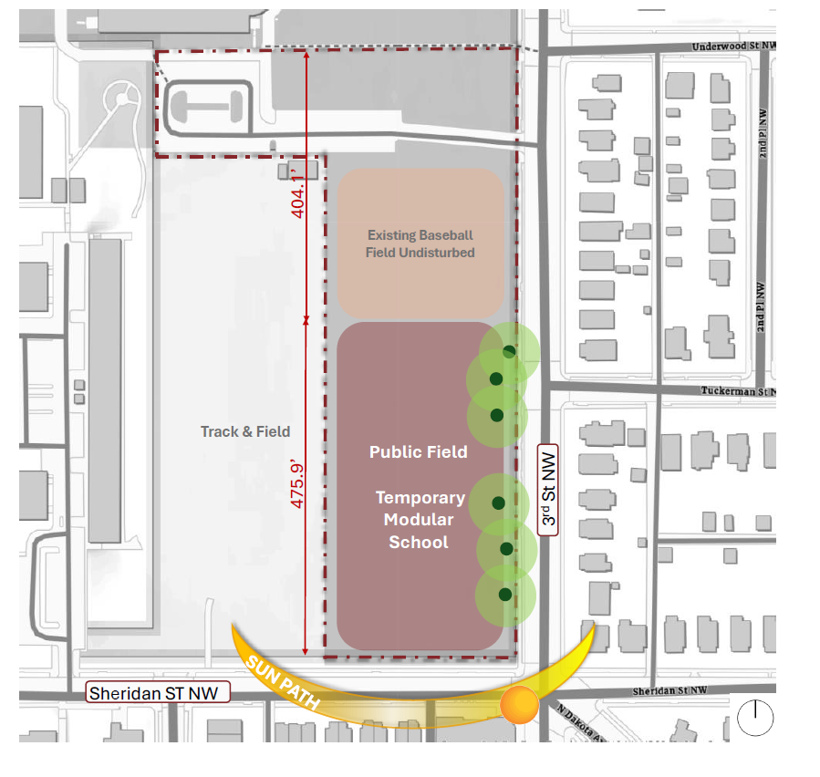
Proposed Siting of Modular Campus

Slide 6
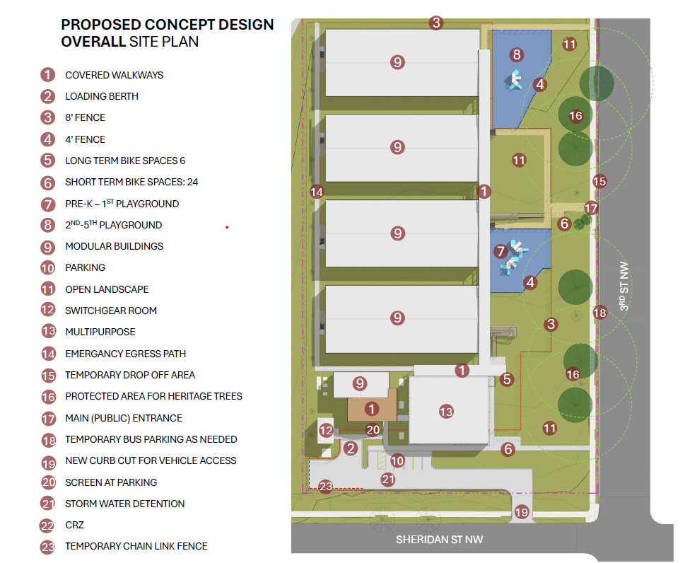
Swing Space Site Plan

Slide 7
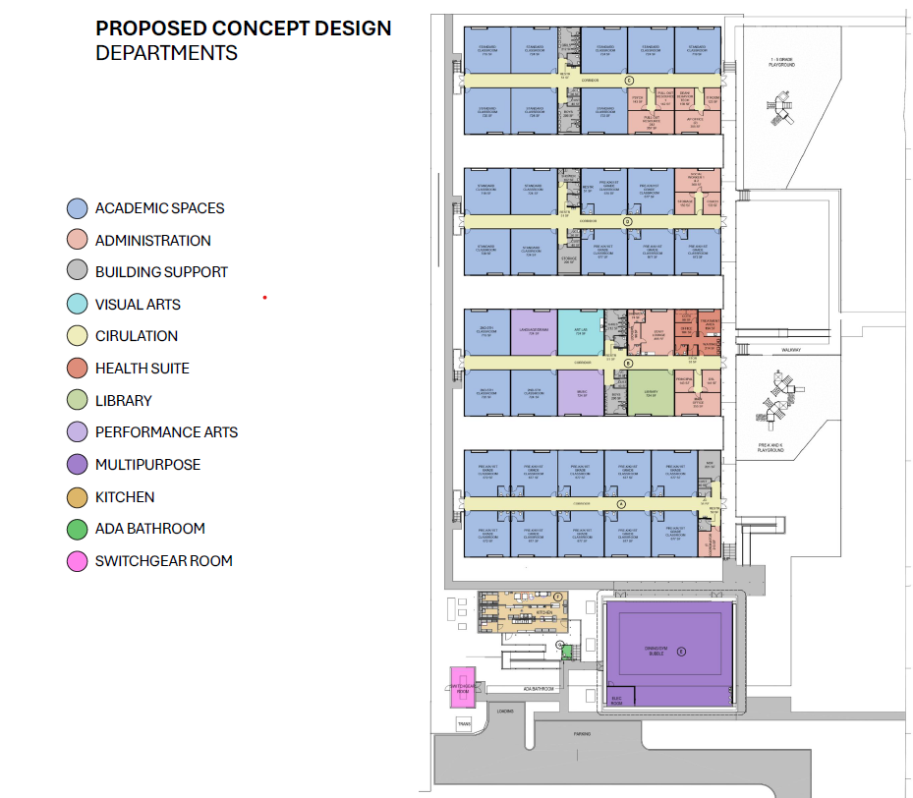
Swing Space Site Plan

Slide 8
Community Outreach
DGS and DCPS have conducted ongoing engagement with families, staff, and neighbors throughout the design and zoning process:
  Since April 1, 2025, the project team has held or attended 4 community meetings, including three School Improvement Team (SIT) sessions.
  The applicant will continue working with the ANC and community throughout the remainder of the project.

Slide 9
Relief Requested
The Applicant requests area variance relief from 11-C DCMR § 302.2, which prohibits more than one principal structure on a single record lot in residential zones.
  The Subject Property will temporarily include a modular swing space composed of multiple detached buildings.
  The swing space is necessary to house students during the school modernization and will consist of five classroom trailers, one kitchen trailer, and a multipurpose “bubble” structure.
  Each modular trailer qualifies as a separate primary building, triggering the need for relief.

Slide 10
BZA Relief Requested-Variance Standard
Pursuant to 11-X DCMR § 1002.1 the Board of Zoning Adjustment may grant area variance relief where the applicant demonstrates that:
  The Property is affected by an extraordinary or exceptional situation or condition;
  The strict application of the Zoning Regulations would result in a practical difficulty to the applicant; and
  The relief can be granted without substantial detriment to the public good and without substantially impairing the intent, purpose, and integrity of the Zoning Regulations and Map

Slide 11
BZA Relief Requested-Exceptional Condition
The Property is affected by a confluence of conditions that qualify as exceptional:
  The Project requires modular construction due to cost, speed, and reversibility. Modular trailers are limited in width and must remain detached to comply with fire separation and transport limits.
  The Property is uniquely suited for multiple primary structures due to its exceptional size, especially in contrast to the predominantly small residential lots that characterize the surrounding neighborhood.

Slide 12
BZA Relief Requested-Practical Difficulty
Strict compliance with the regulations requirements would result in multiple independent hardships:
  Modular units must be constructed within transportable dimensions, making consolidation into a single structure impractical.
  Connecting the units on-site would require enclosing the connections, which would significantly increase construction complexity and cost by triggering additional mechanical, fire safety, and accessibility requirements. These modifications would ultimately undermine the efficiency and affordability of modular construction, defeating its intended purpose.

Slide 13
BZA Relief Requested-No Harm
The variance relief will not cause substantial detriment to the public good or Zoning Regulations
  The site will operate as a public elementary school, a matter-of-right use in the R-1-B zone.
  The swing space is temporary.
  All zoning standards for height, lot occupancy, FAR, parking, and bicycle parking are met.
  The Project preserves open space, playgrounds, and neighborhood character.

Slide 14
Questions?

